Slide 1
Behold Bootstrap!

Slide 2
TA - Marie Trull
Marie Trull
<insert education or experience tidbit>
<insert education or experience tidbit>
Over <#> years coding, (with plenty of experience being a n00b at it.)
Insert image of you here
<personal fact>
Secretly, a <funny fact about yourself>
Insert image here
Notes:
Enough about you, time to talk about me.

Slide 3
TA - Zoe Reagan
Zoe Reagan
<insert education or experience tidbit>
<insert education or experience tidbit>
Over <#> years coding, (with plenty of experience being a n00b at it.)
Insert image of you here
<personal fact>
Secretly, a <funny fact about yourself>
Insert image here
Notes:
Enough about you, time to talk about me.

Slide 4

TA - Dave Leo Shilander
Dave Leo Shilander
Former NU Bootcamp Grad
Volunteered and Subbed for past cohorts.
Self-taught core coding concepts and Linux/ Unix
Over 10 years coding, (with plenty of experience being a n00b at it.)
I’m a singer!
Former chef!
Secretly, a superhero
Insert image here
Notes:
Enough about you, time to talk about me.

Slide 5

TA – Nathaniel Davis
Nathaniel Davis
Bootcamp grad…and just moved to CHICAGO!
Career changer – 10-ish years in media
Over 1 year coding, (with plenty of experience being a n00b at it.)
I’ve been to 42/50 states…
I have been known to occasionally enjoy smooth jazz 🎷
Insert image here
Notes:
Enough about you, time to talk about me.

Slide 6
Instructor - Jon Gear
Jon Gear
BS in Computer Science from Bowling Green
Software Architect @ JDK Technologies
Meetup organizer for Chicago Serverless
Over 10 years coding, (with plenty of experience being a n00b at it.)
Laptop stickers are life
Secretly, a foodie. Ok, not so secretly
Proud Pup Dad
Notes:
Enough about you, time to talk about me.

Slide 7
Some Cool Stuff I Made…
Notes:
Here’s this cool thing I built. It does X and it’s important because Y.
Questions?

Slide 8
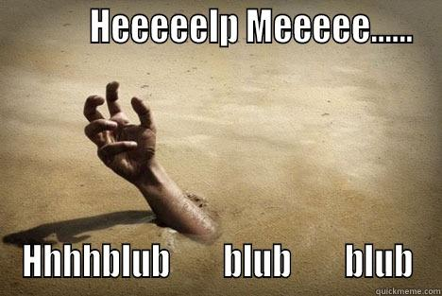

Slide 9
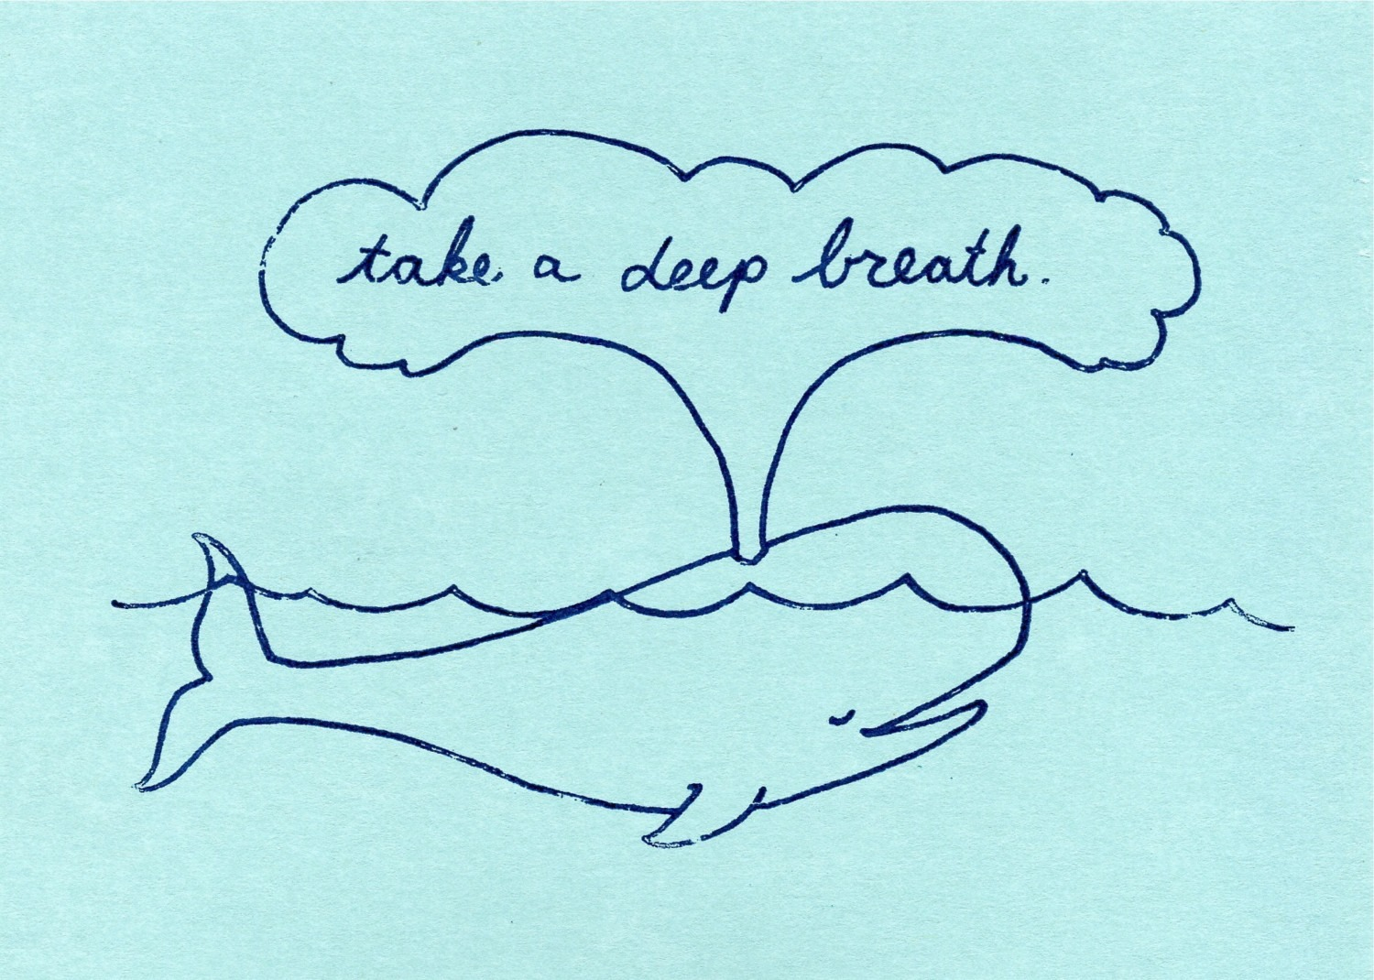

Slide 10


Slide 11


Slide 12
Today’s Class

Slide 13
Objectives
Students will use the Bootstrap CSS Framework to create layouts
Students will learn to use media queries for mobile responsive websites
Students will learn to use the meta tag to make sure all devices are displaying web pages optimally for their viewport.

Slide 14

Focus!
This stuff is important…

Slide 15
Recap Bootstrap

Slide 16
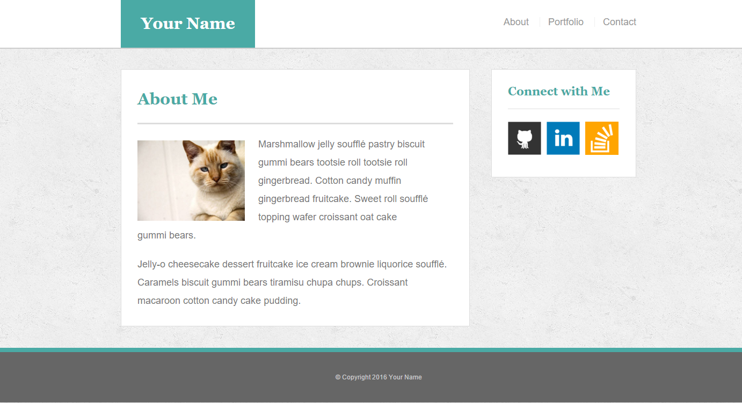
The Pains of HW 1
Plain HTML + CSS makes layout building challenging

Slide 17

How You (Probably) Feel About CSS

Slide 18

But Then Came Bootstrap…

Slide 19


Powered by Bootstrap
External CSS Link
Pre-Defined CSS Class (ex: “Jumbotron”)

Slide 20
Powered by Bootstrap
class=“jumbotron”

Slide 21

Big Deal!!!
Using Bootstrap,
we have PRE-DEFINED CSS Styles.

Slide 22

Why Use Bootstrap?
Reason #1: UI Kit
Familiarize yourself with the UI features it offers via the documentation.
Once Bootstrap is active, you can simply copy snippets from the documentation to save yourself major time of creating elements yourself.

Slide 23

Why Use Bootstrap?
Reason #2: Mobile Responsiveness
One of the most compelling reasons to use Bootstrap is the default mobile-responsive quality it provides.
This means that your website will look “good” automatically when viewed on screens ranging from monitors to tablets to phones.

Slide 24
> YOUR TURN!!
Warmup Activity:
As a repeat of last class, quickly create an HTML webpage.
Then add in a Bootstrap component of your choosing.
Hint: Copy the Bootstrap CSS link. Then copy the code from any Bootstrap element or CSS.

Slide 25
Next Phase Bootstrap
Last class, we focused on Bootstrap Components (like buttons and tables).
Today we’ll be focused on using Bootstrap to build layouts.

Slide 26
Sketching / Grid Layouts

Slide 27

Take a Huge Breath…

Slide 28

FOCUS!
Because in our opinion, these next two sections are some of the
MOST IMPORTANT ONES
in the ENTIRE program.
Facebook surf at your own peril (and to the peril of the galaxy)

Slide 29
FOCUS!
Relax. That doesn’t mean its hard.

Slide 30
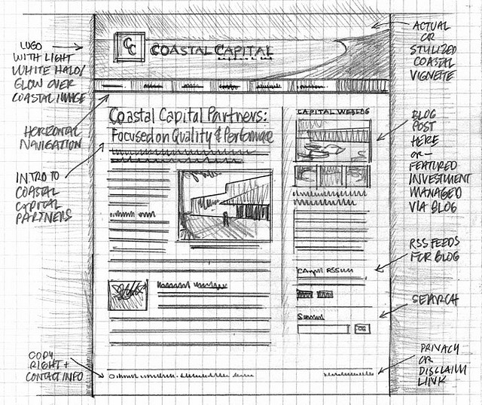
Importance of Sketches
Because every aspect of a site’s “look” is defined by HTML/CSS – it is crucial to have a detailed sketch going in.
Pay particular attention to the location of navigation bars, titles, headers, content, images, footers etc.
When imagining alignments, in particular, be mindful of the grid

Slide 31
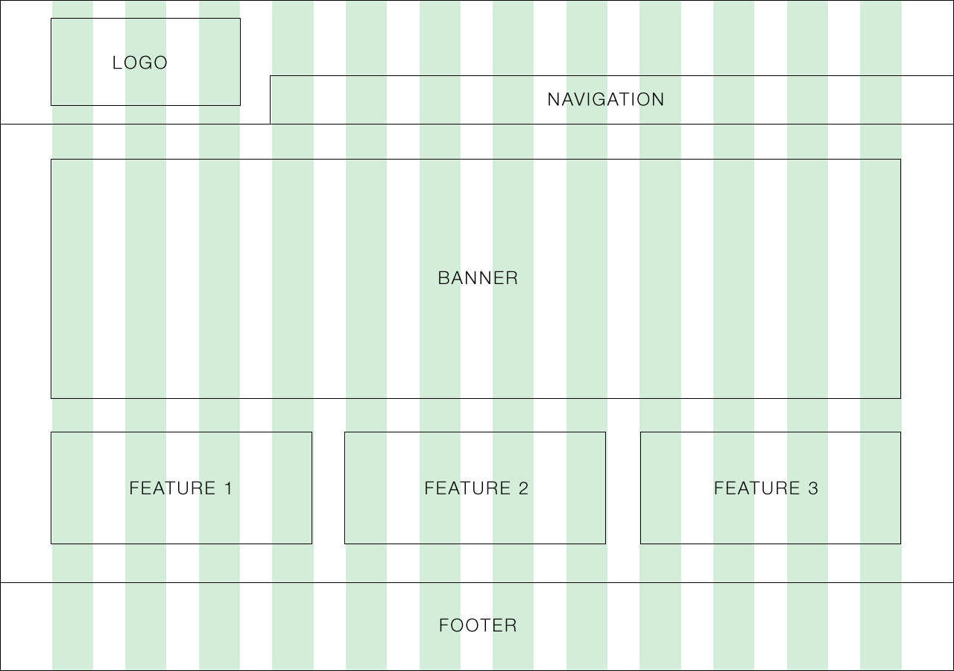
Designing with a Grid in Mind
Grids serve to align elements aesthetically.

Slide 32

Facebook’s Grid
Facebook is a perfect example of a website where the “grid-layout” is obvious.
Grids make it easy to have content (text, images, and regions) align aesthetically.

Slide 33
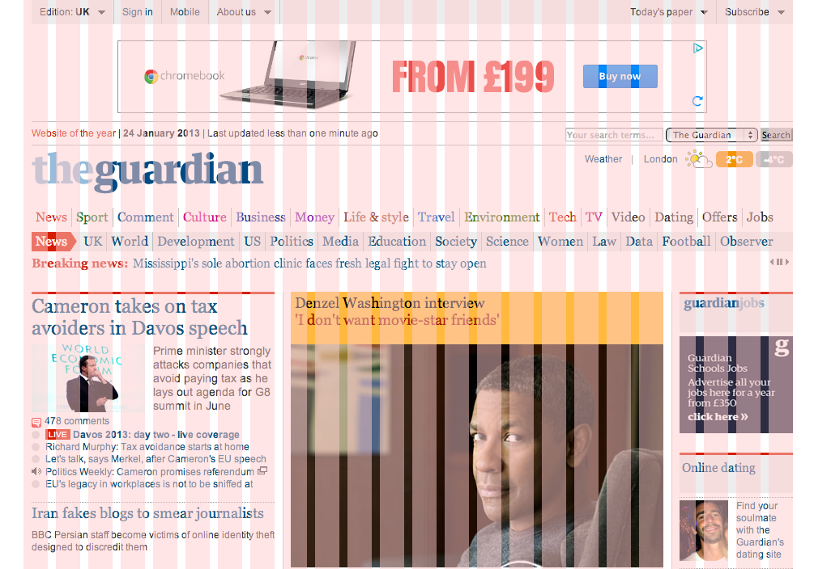
A More Complex Grid…

Slide 34
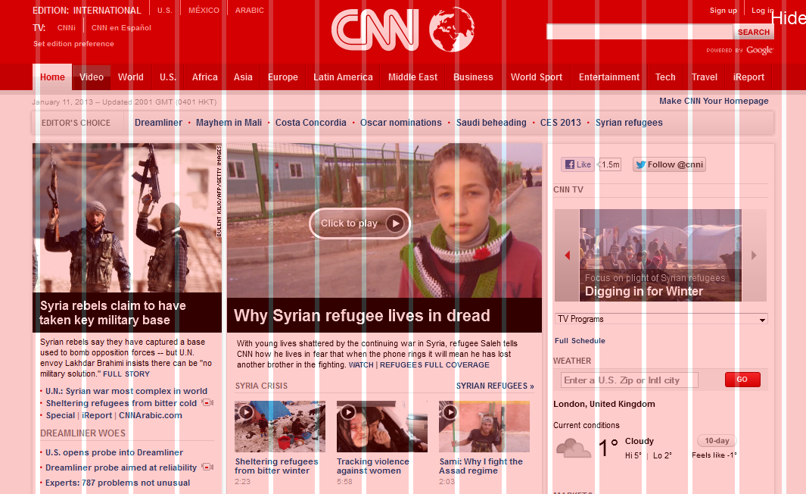
A More Complex Grid…

Slide 35
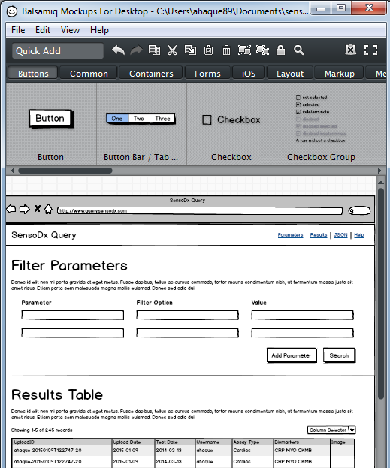
Tools for Sketch / Grid Creation
Wireframing Tools:
Balsamiq***: https://balsamiq.com/
Framebox: http://framebox.org/
Pen and Paper: Your notebook
Grids for Photoshop / Illustrator:
960 GS: http://960.gs/
GuideGuide: https://guideguide.me/
Designing with Grids Guides:
960 Grid System Made Easy: http://bit.ly/1sjYaFC
Design by Grid: http://www.designbygrid.com/
Designing with Grid-Based Approach: http://bit.ly/1CM4Hzo

Slide 36
Rows and Columns
Workshop

Slide 37
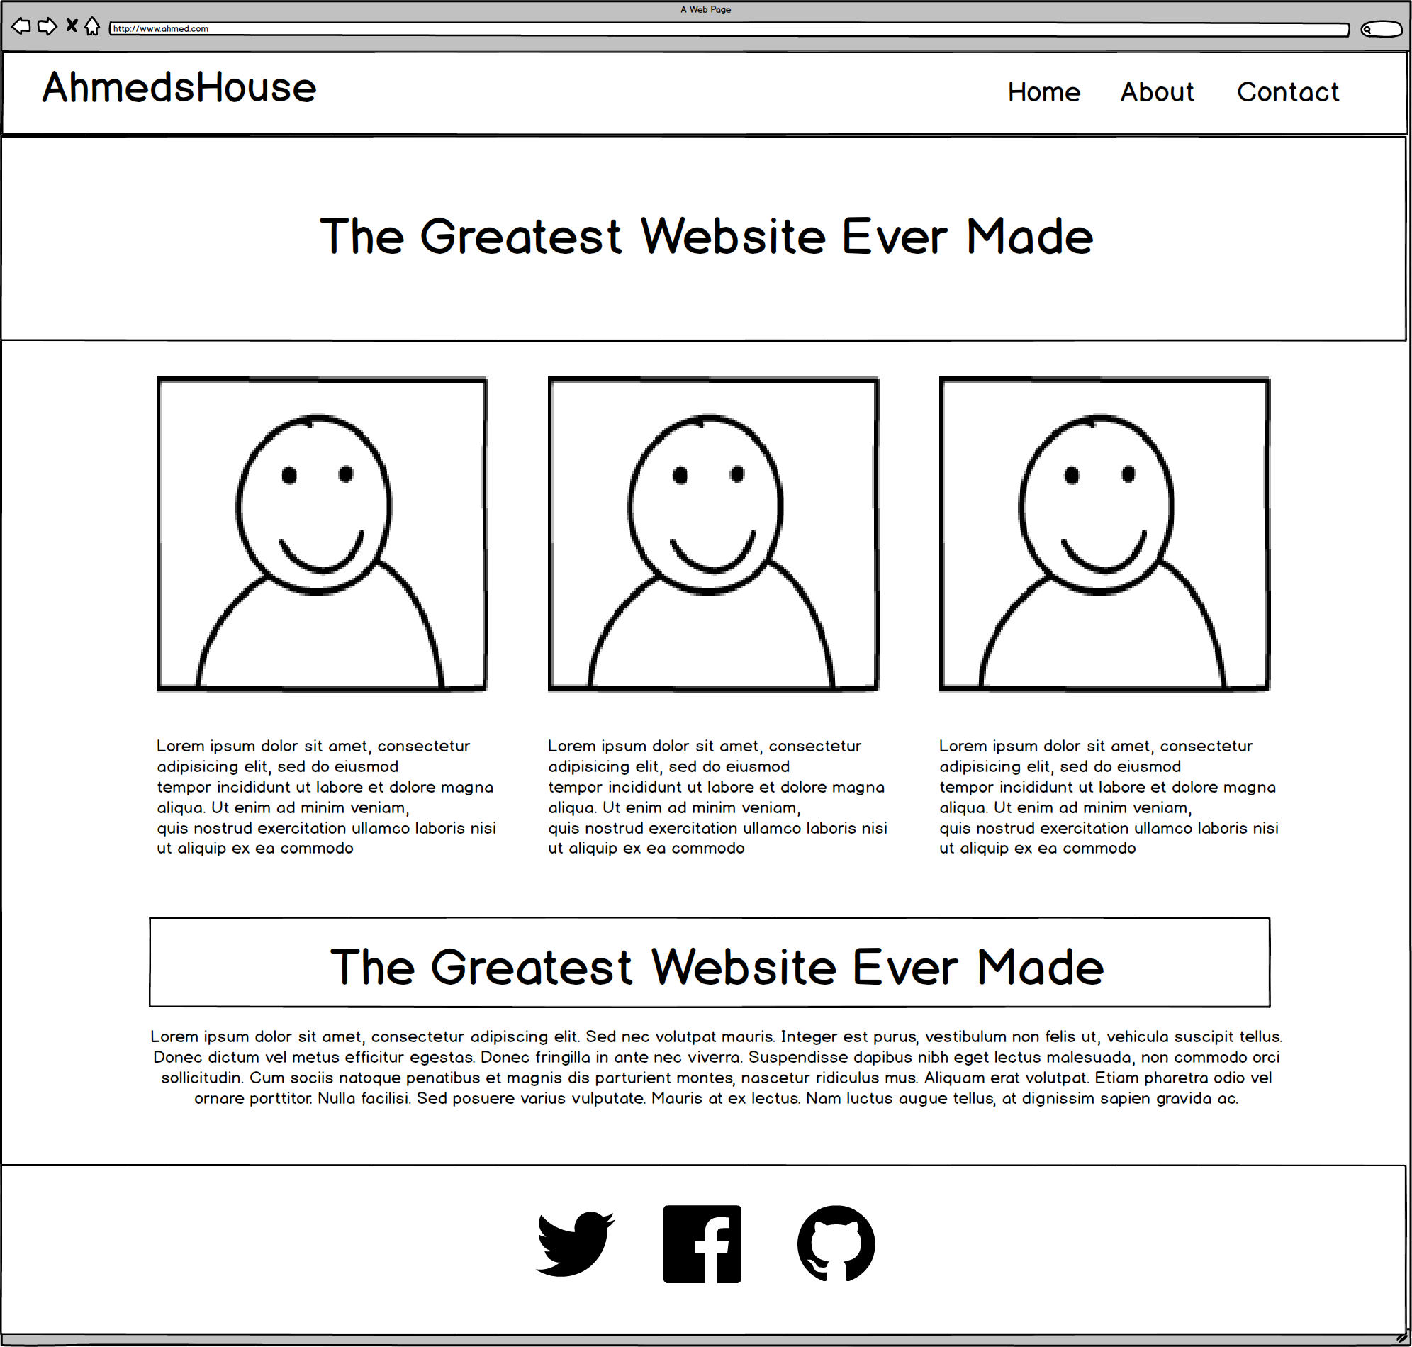
Web Design Fundamentally = Wireframes

Slide 38
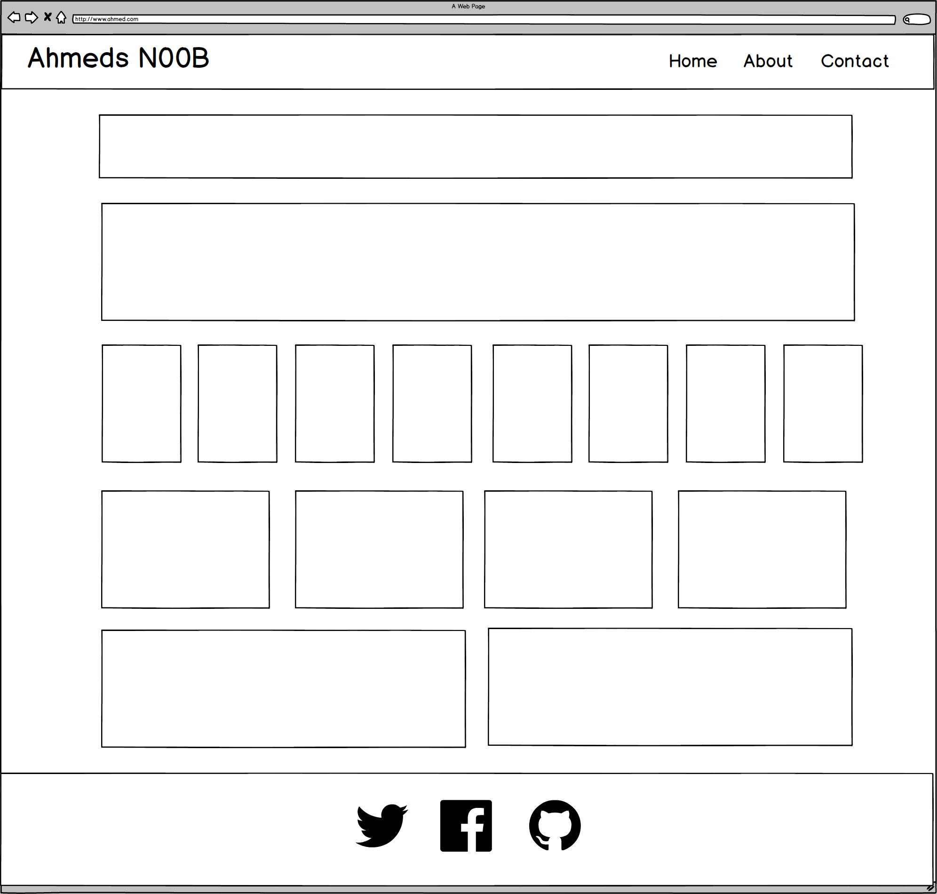
Notes:
7:00 – 7:05

Slide 39
ROWS
1
1
1
1
1
6 Total
1
Notes:
7:00 – 7:05

Slide 40
COLUMNS
1
1
8
4
2
1
Total Not relevant
Notes:
7:00 – 7:05

Slide 41
You Try!
Notes:
7:00 – 7:05

Slide 42
Level Up!
Now, let’s make it more challenging…

Slide 43
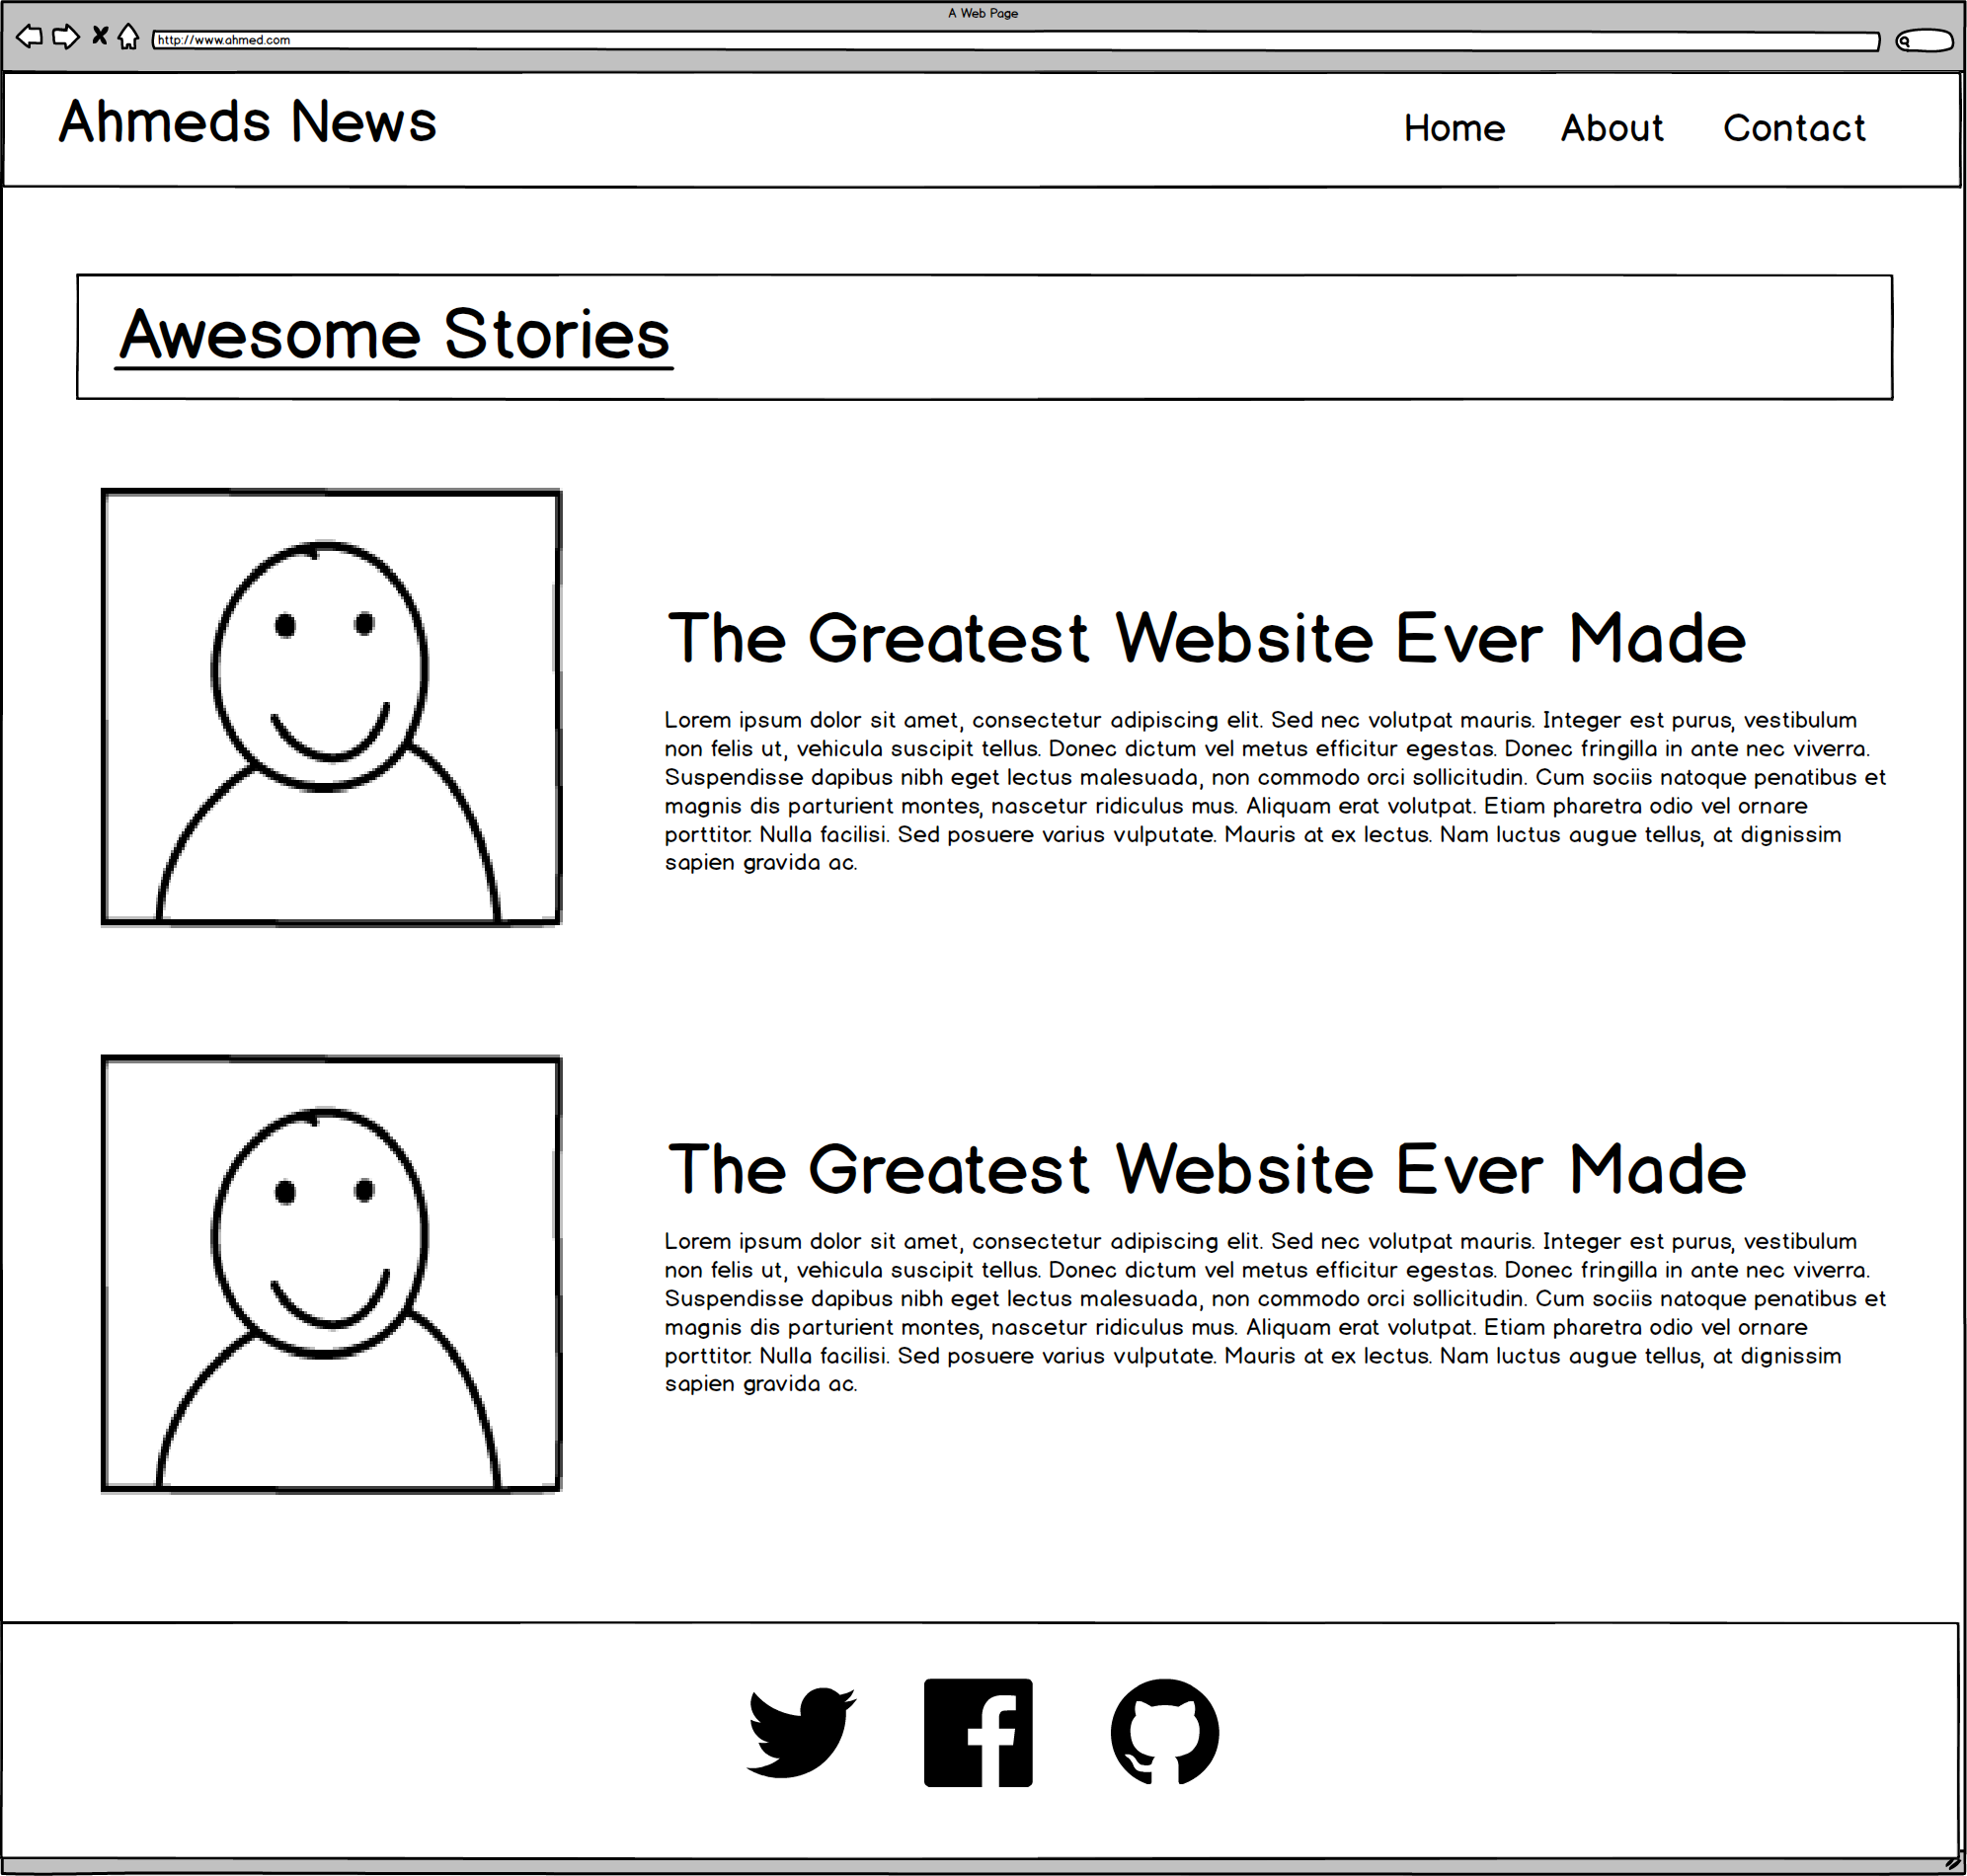
Notes:
7:00 – 7:05

Slide 44
ROWS
1
1
1
4
Total
1
Notes:
7:00 – 7:05

Slide 45
COLUMNS
1
2
2
1
Total Not relevant
Notes:
7:00 – 7:05

Slide 46
Level Up!
Now for another…

Slide 47
Notes:
7:00 – 7:05

Slide 48
ROWS
1
1***
1
4
Total
1
Notes:
7:00 – 7:05

Slide 49
COLUMNS
1
3
1
1
Total Not relevant
Notes:
7:00 – 7:05

Slide 50
You Try!
Notes:
7:00 – 7:05

Slide 51
Level Up!
This final one is tricky…

Slide 52

Notes:
7:00 – 7:05

Slide 53
Level Up!
Didn’t quite work right?
For this one we need sub-rows and sub-columns

Slide 54
ROWS
1
1***
1***
4
Total
1
Notes:
7:00 – 7:05

Slide 55
COLUMNS
1
2
1
Total Not relevant
Notes:
7:00 – 7:05

Slide 56
SUB-
ROWS
1
1
1
1
4
Total
Notes:
7:00 – 7:05

Slide 57
SUB-
COLUMNS
2
1
Notes:
7:00 – 7:05

Slide 58
You Try!
Notes:
7:00 – 7:05

Slide 59

Notes:
7:00 – 7:05

Slide 60
Grid Design with Bootstrap

Slide 61

More Genius Time!
Warning!
This is a fairly “tricky”… but VERY IMPORTANT topic.
Time to channel that inner genius.

Slide 63
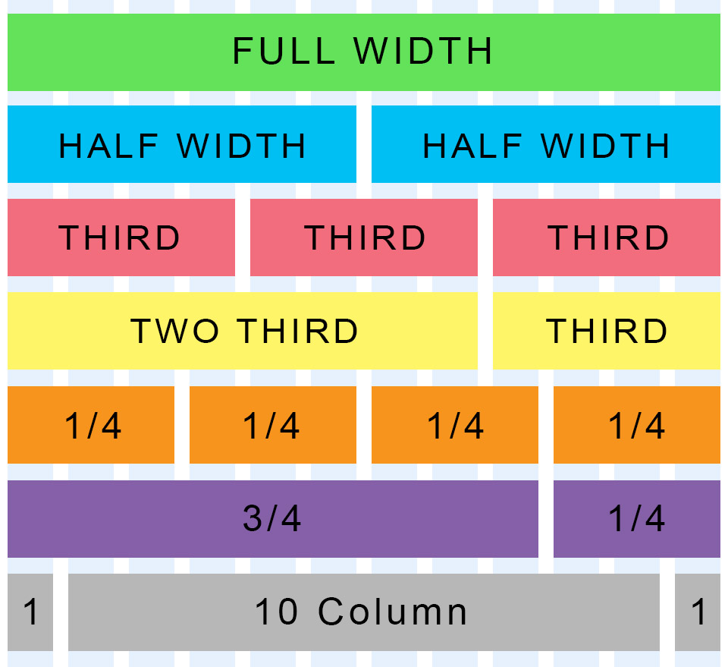
Bootstrap Grid
Bootstrap lets you organize content based on the “number of columns” a div spans – out of a total 12 columns.
Example:
<div class="col-md-12">
(Spans full width)
<div class="col-md-4">
(Spans 1/3 of full width)

Slide 64
Bootstrap Grids
Every Bootstrap Grid is made up of…
containers - which wrap around the entire grid
rows - which are defined first and are just rows
columns - which are defined within rows and specify the columns. The sum total of all columns within a row must add up to 12.
Each of these elements is implemented by creating a div with a specific class name.

Slide 65
Defining Columns
Container
Row #1
Column#1
Column#2
Column#3
Column#4

Slide 66
> YOUR TURN!!
Quick Activity:
Turn to your neighbors and explain to one another:
The relationship between containers, rows, and columns. (Draw it on a piece of paper for them)
The syntax for each.
The specific syntax details for columns.

Slide 67
Coding Grids

Slide 68
INSTRUCTOR DEMO!
Instructor: Demo
(quickgrid.html | 13-InstructorGrids)

Slide 69

Bootstrap Grid
Note the rows, columns (col-lg-6), and containers

Slide 70

Bootstrap Grid
Note the rows, columns (col-lg-6), and containers

Slide 71

Defining Containers
“Containers” are like the box that the entire grid sits inside.

Slide 72

Defining Rows
“Rows” are like the rows we talked about earlier.

Slide 73

Defining Columns
“Columns” fit inside of rows. Note the syntax: col-sz-#
Col = column
sz = viewing size (in this case: medium)
# = number of “columns taken” out of 12. (in this case 4 of 12)

Slide 74
> YOUR TURN!!
Activity:
Using Bootstrap, create a layout that looks like the one shown on the next screen.
Spend some time prior to coding to draw out the grid layout
Count the number of rows and columns
Then use the bootstrap grid syntax to code it out.
Slack a screenshot of your page when you are done.
Ipsum Generator: http://www.lipsum.com/

Slide 75

> YOUR TURN!!

Slide 76
Building Bootstrap Layouts

Slide 77
INSTRUCTOR DEMO!
Instructor: Demo
(InClass-DemoLayout.html | 15-InstructorLayout)

Slide 78
> YOUR TURN!!
Activity:
Working in pairs and using Bootstrap make the following design.
Be sure to note the:
Grid Layout
Navbar
Sidebar card
Thumbnail
Additional details will be sent to you via slack.

Slide 79
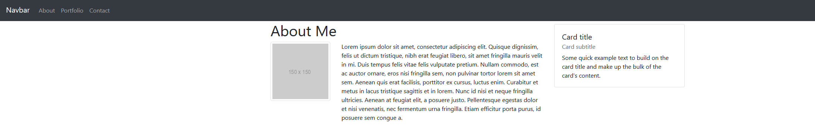
> YOUR TURN!!

Slide 80
Common Questions
Can I reverse the order (i.e. rows inside columns)? Not usually. Columns should go inside of rows. Though, you can create sub-rows inside of columns. But those columns would still need to be inside of a row of their own.
Can I just avoid having a container? You could… But it will mess things up. Just throw in a container.
What if I have columns that go past 12? Then your bootstrap grid won’t behave as expected. Don’t go past 12.
What if I don’t add up to 12? Nothing. You will have empty space at the end. But be careful, because the next column you add in this row will fill up the empty space (sometimes without your intention).

Slide 82
Mobile Responsive (HW)

Slide 83

Still No Facebook Time
Warning!
This next section matters a lot for your homework

Slide 84
Media Queries
Media Queries define how CSS styles are applied in relation to the characteristics of the device viewport.
Through media queries we can change the way a web page is displayed based on width, height, orientation, and even media type (screen, paper, braille, etc).
Bootstrap extensively uses media queries under the hood to help you create mobile responsive websites.
But remember! Media queries must be declared last.

Slide 85
INSTRUCTOR DEMO!
Instructor: Demo
(17-InstructorMedia)

Slide 86
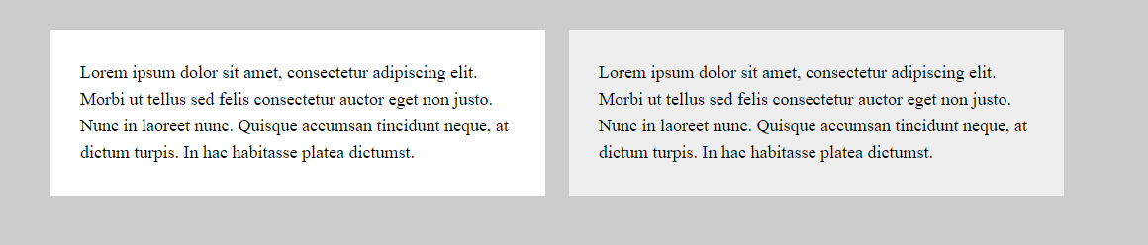
Quick Demo

Slide 87
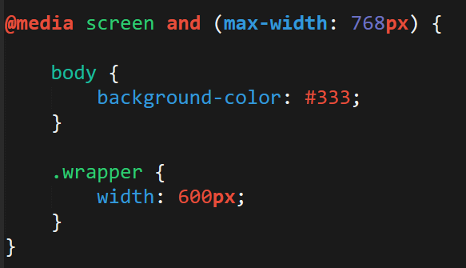
> YOUR TURN!!
Activity:
Explain to your partner what the following CSS code does:

Slide 88
> YOUR TURN!!
Activity:
Build your own mobile responsive HTML /CSS page using media queries.
Just follow the steps sent to you via Slack.

Slide 89
Viewport
Viewport refers to the display being used to view the website.
By default, mobile devices with small screen, high resolution viewports may render content at a typical desktop screen ratio (scaled down at the smaller screen size).
We can specify that a web page should scale its content to the width of its current viewport using a `meta` tag.

Slide 90


Viewport
No Viewport Content Scaling
Yes Viewport Content Scaling

Slide 91
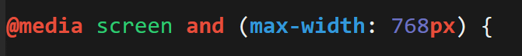
Viewport Inclusion
Just include this line in the head
And then include a variety of @media queries for various sized screens.

Slide 92
> YOUR TURN!!
Activity:
Spend the next few moments on the site viewportemulator.com and visit your favorite websites using various viewports.
Notice how the sites change display wise.

Slide 93


Slide 94
Questions?

Slide 95
Extra Challenge
Time Permitting

Slide 96
> YOUR TURN!!
Activity:
With those around you (and using Bootstrap CSS), create a complex layout of your own.
You can use the layout provided to you as a guide, starting point, inspiration, or not at all.

Slide 97
